Slide 1


ENERGY STAR Portfolio Manager
Last Updated: October 2025

Slide 2

The Facts
Congress established ENERGY STAR in 1992 under President H. W. Bush and subsequently passed multiple bipartisan laws explicitly requiring U.S. EPA and U.S. DOE to create and maintain ENERGY STAR
Notes:
Clean Air Act Section 103(g). US Code 7403. (Per Colleen)

Slide 3
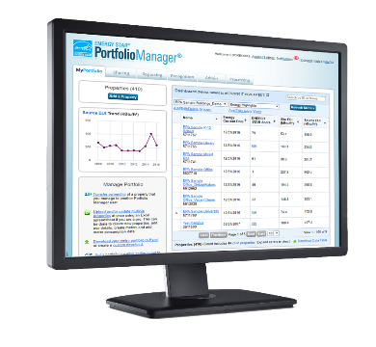


Free. Online. Secure.
energystar.gov/benchmark
Created by US EPA in 1999
Apples-to-apples comparisons help owners save energy
100,000+ users
330,000+ buildings benchmarked last year
25% of all commercial floorspace
Notes:
More than 330,000 buildings, comprising more than 33 billion square feet of floorspace, currently use Portfolio to measure and track their energy use, water use, and waste and materials.
These buildings account for nearly 25% of all commercial building floorspace in the US
Additionally, dozens of state and local governments rely on the tool for benchmarking and BPS policies, and our neighbor to the north has a licensing agreement with us to offer to the tool in Canada.
It’s also worth noting that the tool is currently undergoing its largest update in over a decade, funded by the IRA, to refresh the user experience and add new functionality.

Slide 4
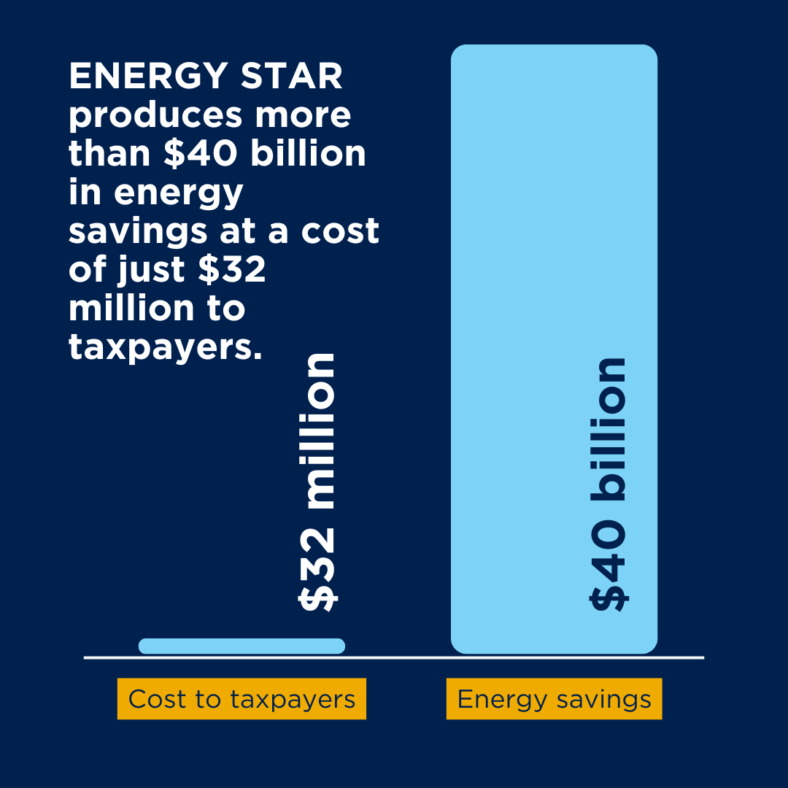
The Business Case
Letters, slides, and data available at
www.imt.org/news/energy-star

Slide 5

Biz Case for
ENERGY STAR
ENERGY STAR is a bipartisan public-private partnership that benefits the economy through energy and cost savings
ENERGY STAR includes programs for products, industry, homes, and commercial buildings
Every year ENERGY STAR generates approximately $40 billion in energy savings at a cost of just $32 million – a 350x ROI!
ENERGY STAR saves average American household $450 per year
  Urge businesses to take action to protect ENERGY STAR

Slide 6
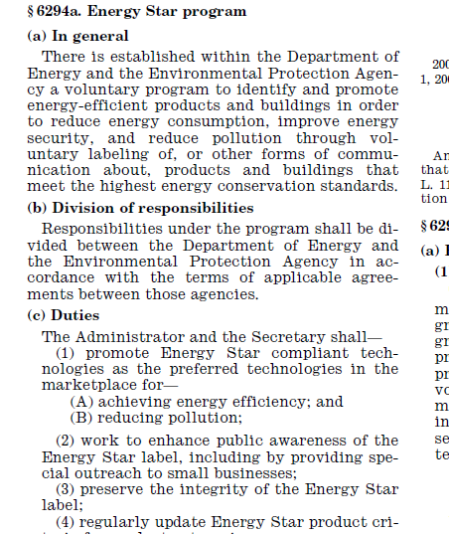
ENERGY STAR Statutory Basis
Notes:
Energy Act of 2005

